Slide 1
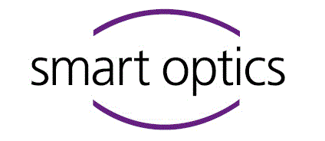


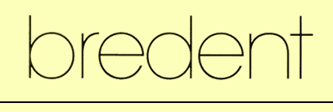
Investigation of the Coloring Behavior of Zirconiumdioxide (ZrO₂) Dental Ceramics by Ink-jet Printing of Metal-ionic Inks
Furkan Öztürk
Betreuer: Dipl.-Ing. Dominik Rumschöttel
Notes:
Dear Prof doc and fellow researchers

Slide 2
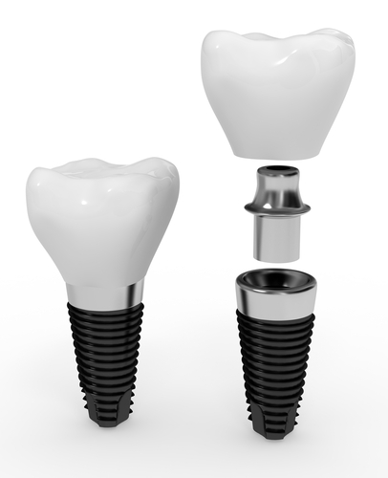
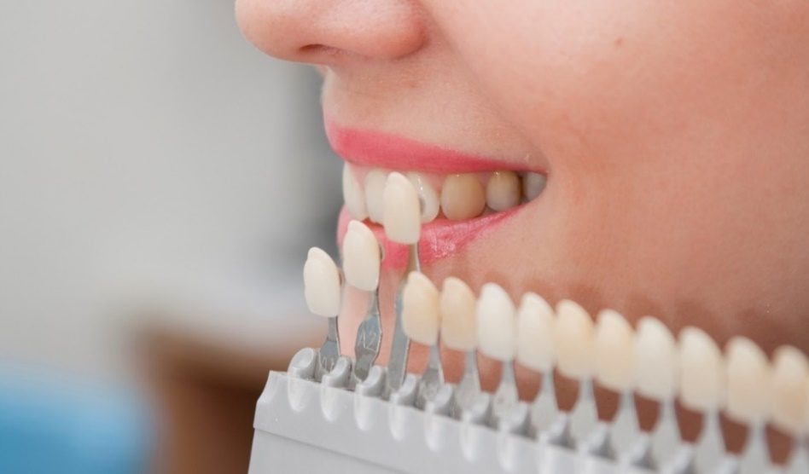
1. Application
More then 1 Million tooth replacements annually
(Deutsche Gesellschaft für Implantologie im Zahn-, Mund- und Kieferbereich e. V.
(DGI), 2018)
Zirconia the most popular material
Translucent ceramic crowns (Vasiliev, 2011)
Crown, abutment and implant
(ecoDenta)
Color determination procedure
Notes:
Only in Germany more than 1 M teeth are replaced annually.
A replacement tooth basically consists of an implant, an abutment and a crown
The most popular Crown material is Zirconia
-because of its strength and high translucency like a natural tooth
-but zirconia is naturally plain white so coloring is necessary
-dentist are using such a shade guide for a side by side comparison to determine the color and the shade of the teeth.
- you will see that there are 4 color groups A B C and D and each of these colors have 4 shades coded with the numbers from 1 to 4. Where 1 is the least and 4 is the most saturated shade for each color. Therefor a dental technician uses 16 ink shades at least.

Slide 3
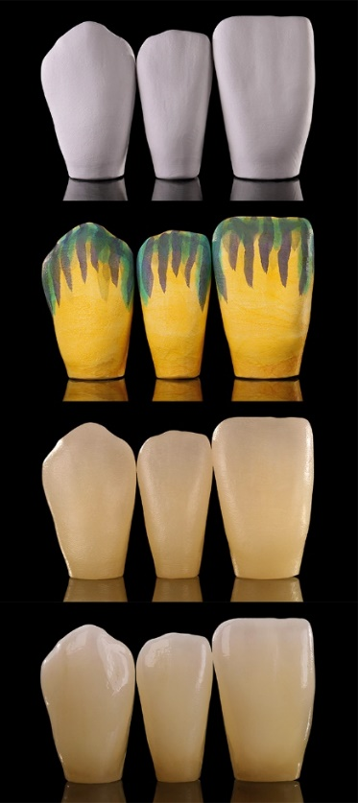
2. State of the Art
Making of dental implants by
dental technologist:
Milling
Manual
Coloring
Furnacing
Polishing
Markings made by dentist
Cutout of a lab card (Sharpling, 2015)
(Zirkonzahn GmbH, 2018)
Notes:
Skala renkler

Slide 4
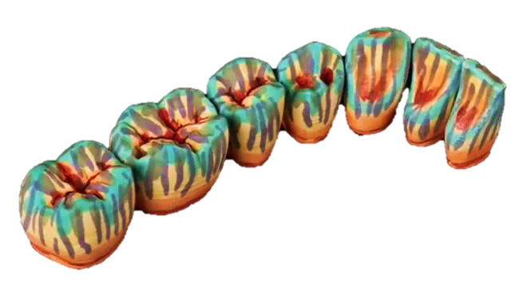
3. Drawbacks of the State of the Art
Time consuming : ~ 5 Minutes per tooth (IDS CAD Ltd., 2015)
Experienced dental technologists needed
Sequential shading precision concerns
False colored crowns after manual brushing (Zirkonzahn GmbH, 2018)
Notes:
Seq- to be taken whether natural or unprofessional

Slide 5
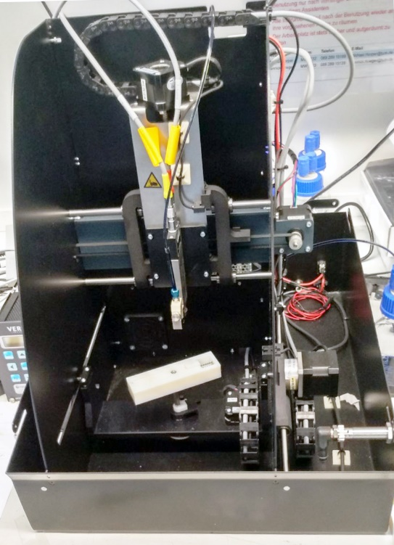
4. Assignment
Determination of the parameters for the printing system (Drop volume, repetition rate, max. printing distance…)
Selection of a proper droplet generator (Piezoelectric vs. Electromagnetic)
Development of a process for the generation of dental color shades using an inkjet printer
Verification of the process results with the existing color standards
5-Axis dental printer prototype provided by Bredent

Slide 6
5. Expected Advantages
Detailed knowlegde of the printing process is the prerequisite for successful automation
Which leads to:
Shorter lead time
High reproducibility
High resolution & low segregation

Slide 7
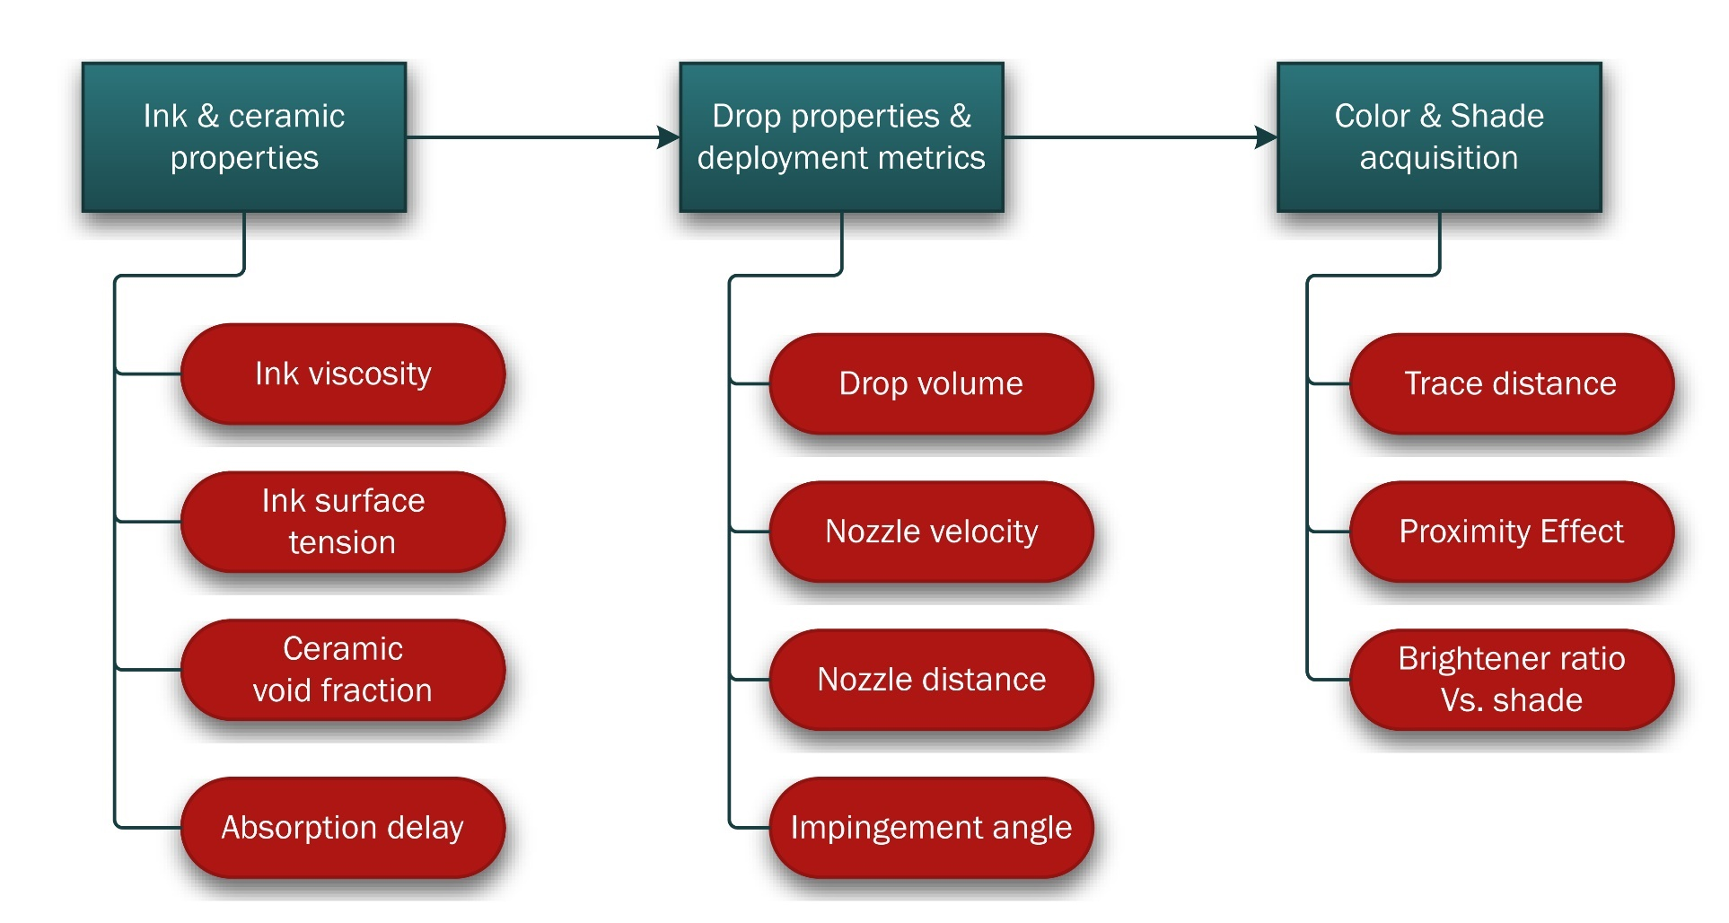
7. Concept (Structure)
Drop impingement analysis
Diffusiveness parameters
Resolution optimization
Multicolor shade arrangement

Slide 8
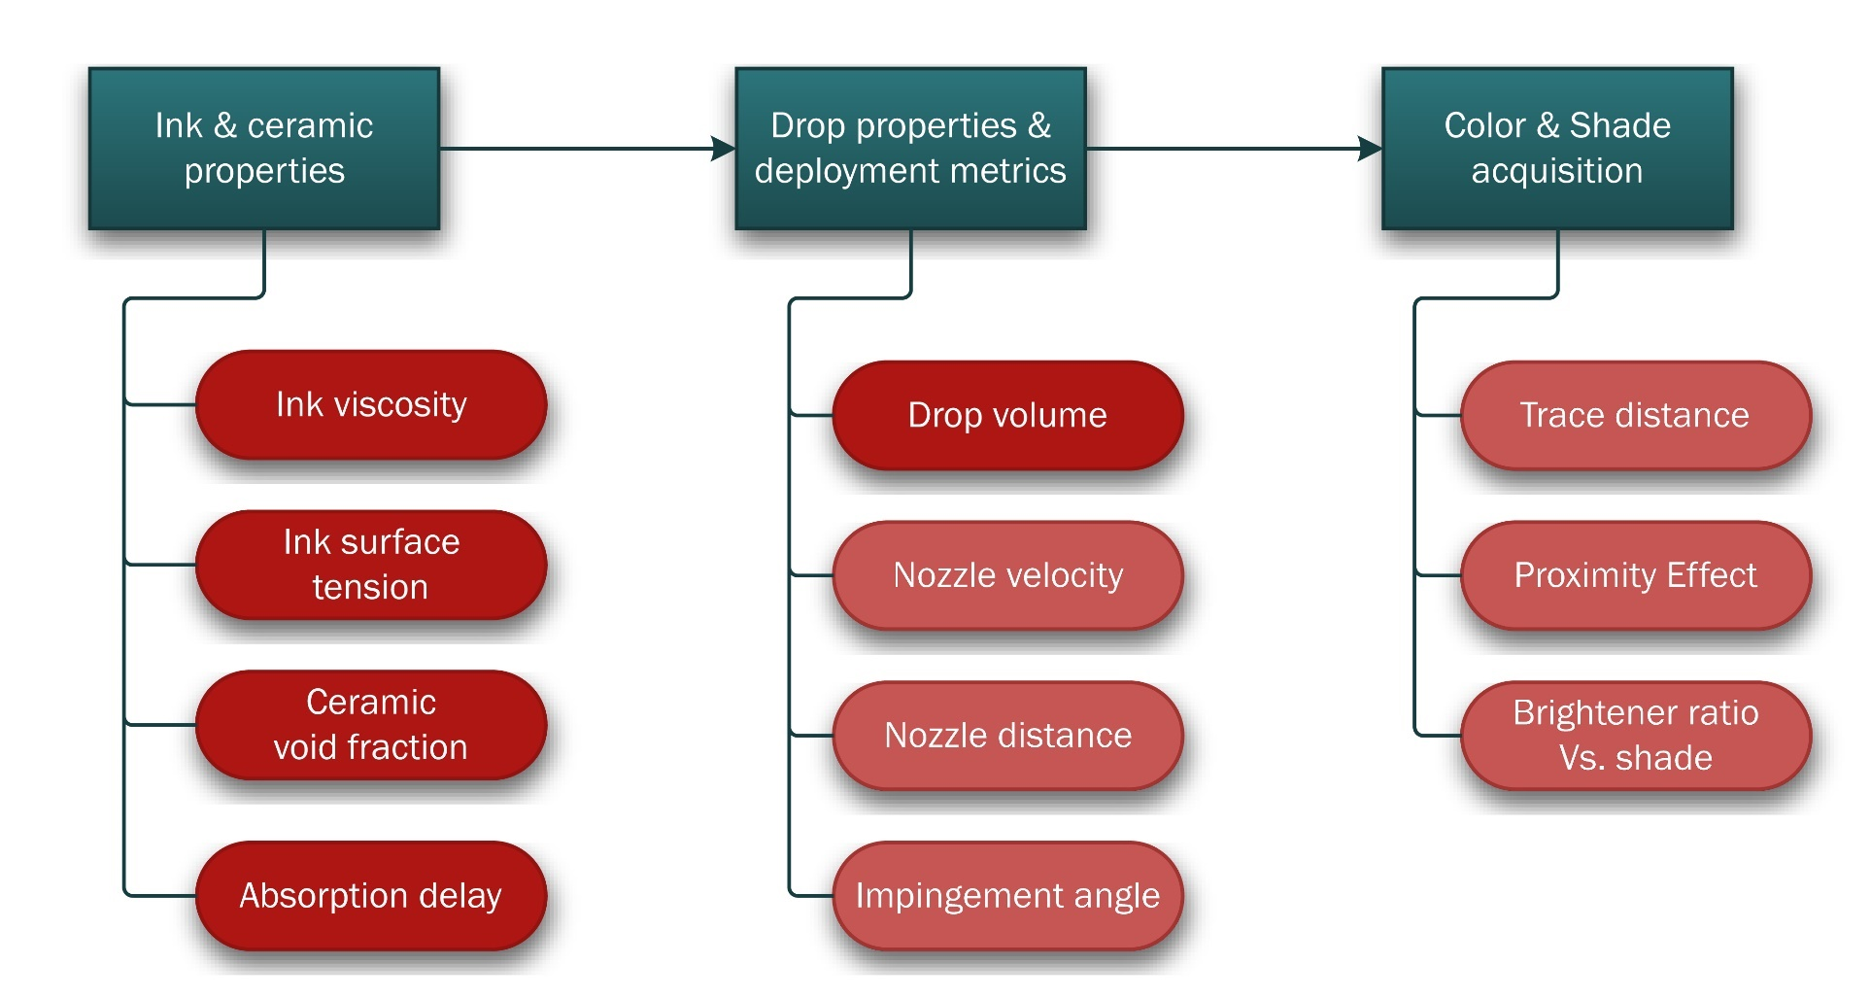
7. Concept (Structure)
Drop impingement analysis
Diffusiveness parameters
Resolution optimization
Multicolor shade arrangement

Slide 9
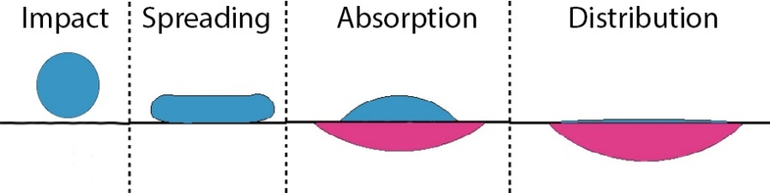
6. Concept (Process)
Developing models for absorption of the ink
Deposition of microdrops on the Zirconia surface
Maximum printing standoff distance & impingement angle
Mixing the 4 base inks with the brightener
Obtaining 16+ shades
Behavior of drops in porous material (based on Lee et al.,2016)
Notes:
3stages Why brightener –mixing or sequential deployment too slow not enough to escape, too fast splash

Slide 10
8. Claim
First color shade generation approach using
base ink colors with a diluter
First automated printing approach in
dental coloring

Slide 11
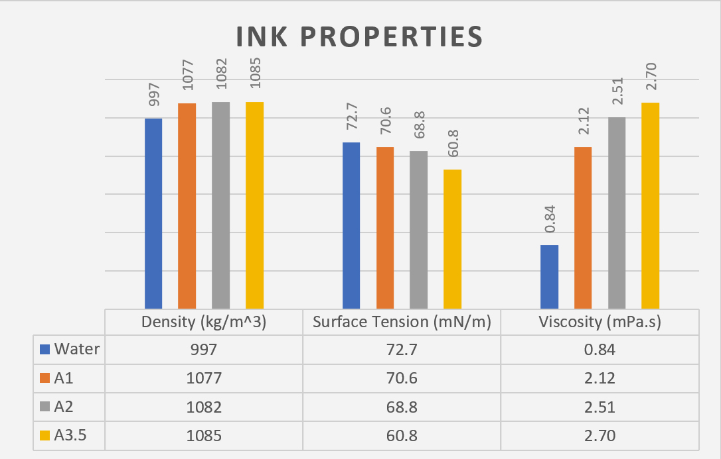
9. Experiment 1 (Material Properties)
Quantitative information for automation
Density, surface tension, and viscosity measurements with
Haake RS100 Viskometer
Lauda TD1 Tensiometer
Dental inks provided by ON-DENT Ltd.
Porosity measurement of the Zirconia blank via gravimetric method
43% Void fraction
Notes:
Experiment zum Nachweis der Eigenschaft …

Slide 12
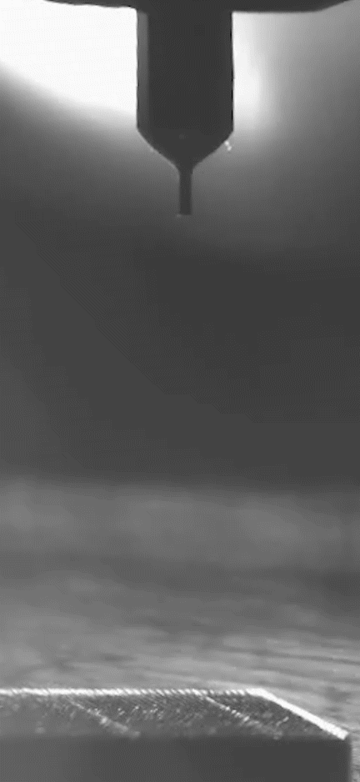
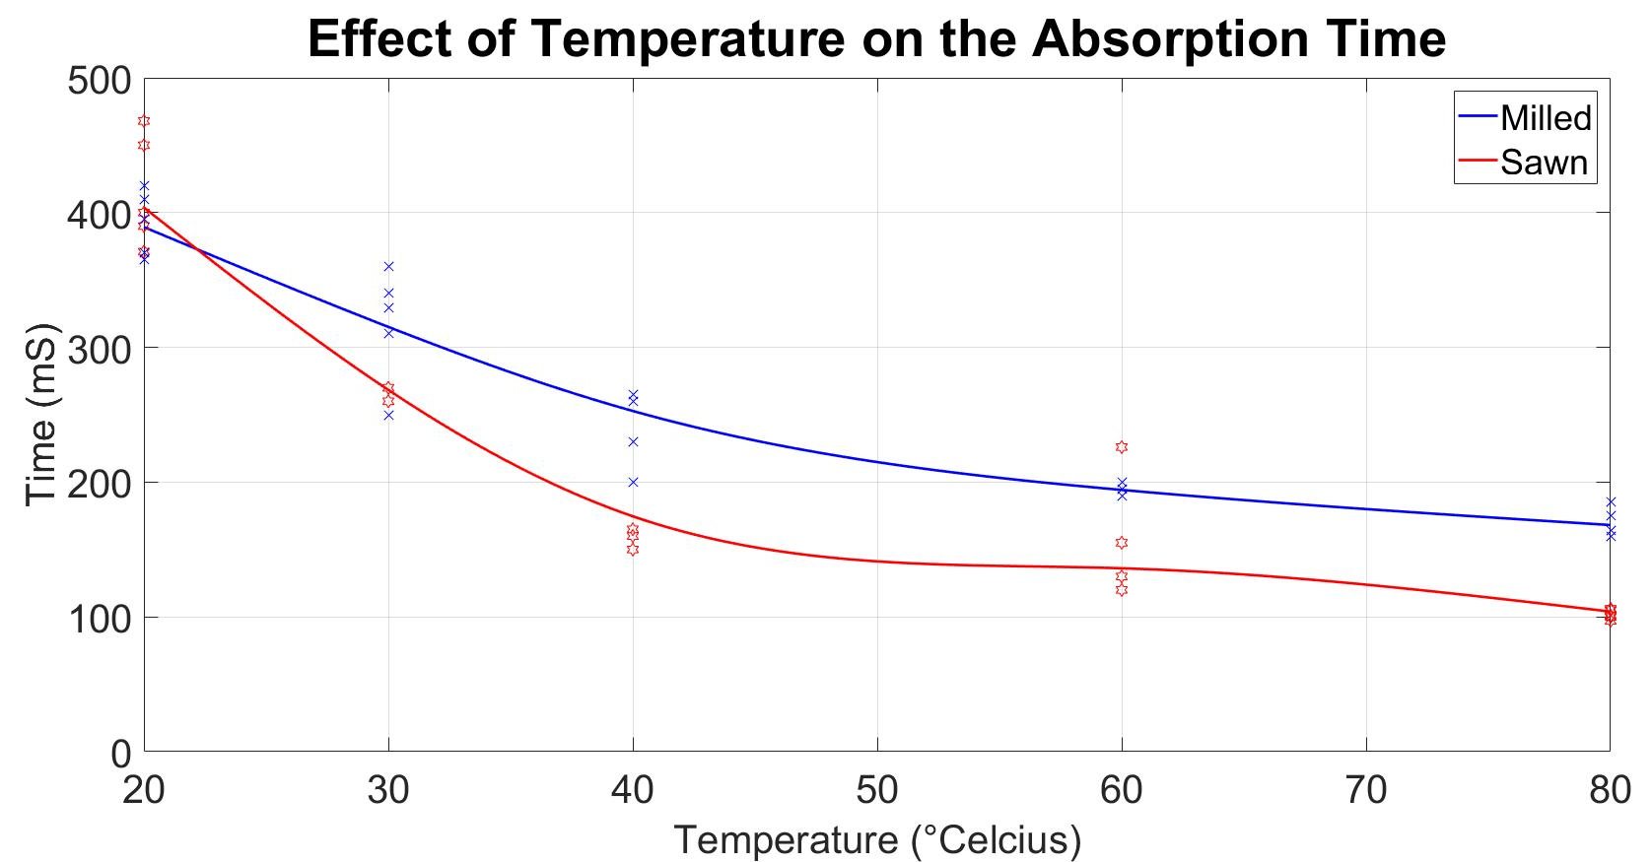
10. Experiment 2 (Absorption Time)
Absorption time limits maximum printing speed
Finding out whether a heater is necessary
Absorption of 100 nL Drops on the Zirconia Surface
( 35x slower)
A change of 60 ºC causes 50% reduction in time
Notes:
Gerät / Messaufbau / Lösung

Slide 13
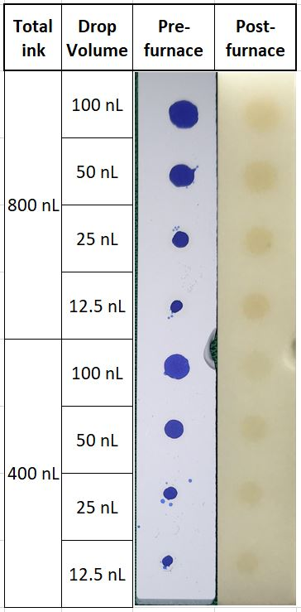
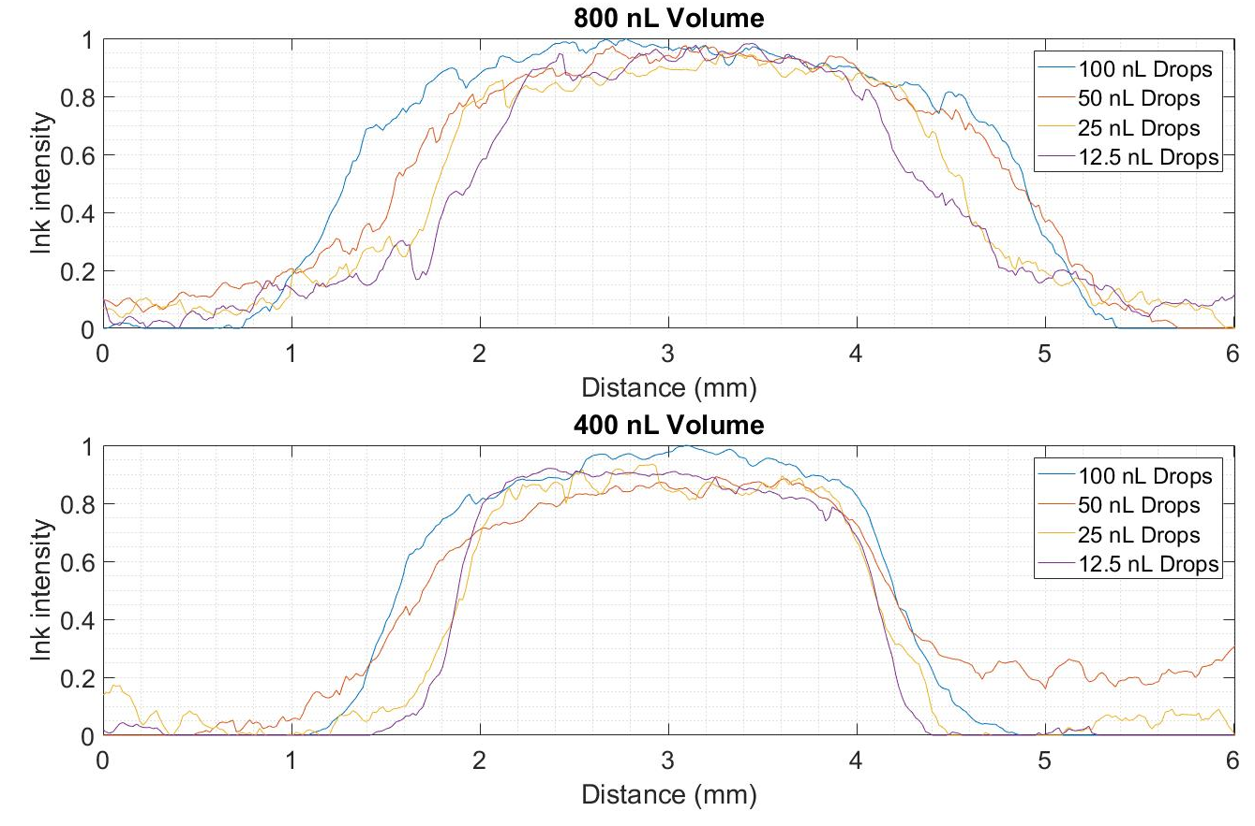
11. Experiment 3 (Drop Size)
Choice of droplet generator (piezoelectric or magnetic) depends on the needed droplet size
Lateral color distribution in relation to the drop volume

Slide 14
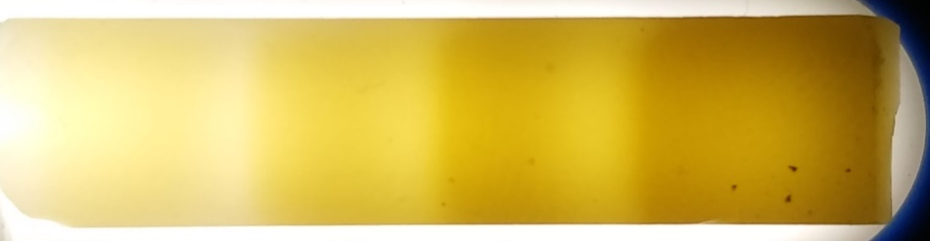
12. Summary
Automated inkjet printing of dental colors is proven to be possible
25 nL is the largest drop size that does not negatively impact the printing resolution
Contrary to the statements of the ink manufacturer the ink properties differ significantly from the properties of pure Water
Zirconia specimen with 4 shades of the color A

Slide 15
12. Outlook
Optimization of ink application on the surface
Nozzle velocity
Max. distance
Max. impingement angle
Developing a model for the shade composition
Trace distance
Proximity effect
Brightener to base Ink ratio

Slide 16
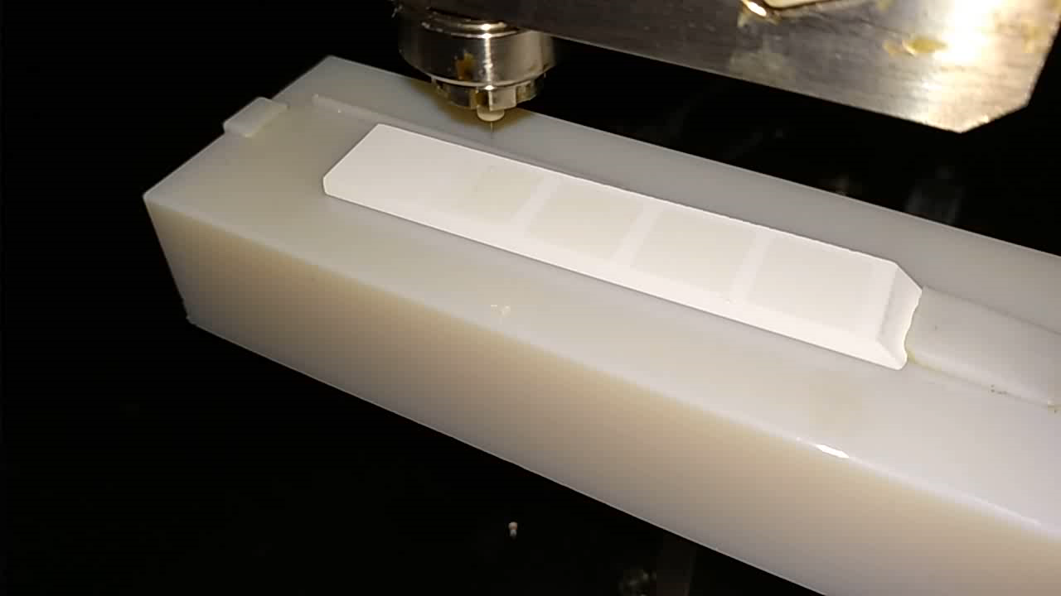
13. Printing process
Printing process on a zirconia specimen

Slide 17

Vielen Dank!
References:
Lee, J. B., Radu, A. I., Vontobel, P., Derome, D., & Carmeliet, J. (2016). Absorption of impinging water droplet in porous stones. Journal of colloid and interface science, 471, 59-70.
Sharpling, B., & Wilson, N. (2015). Teamwork with the Dental Technologist. In Principles and Practice of Esthetic Dentistry (pp. 215-229).
Vasiliev, A. A., Lipilin, A. S., Lagutin, A. S., Pisliakov, A. V., Zaretskiy, N. P., Samotaev, N. N., & Sokolov, A. V. (2011, May). Gas sensors based on MEMS structures made of ceramic ZrO 2/Y 2 O 3 material. In Smart Sensors, Actuators, and MEMS V (Vol. 8066, p. 80660N). International Society for Optics and Photonics.
www.mimed.de
Notes:
Bitte Referenzen alphabetisch ordnen.

